Slide 1
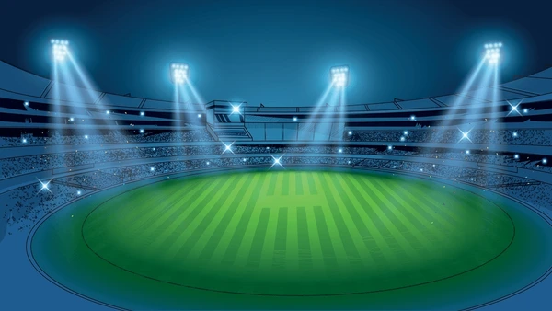
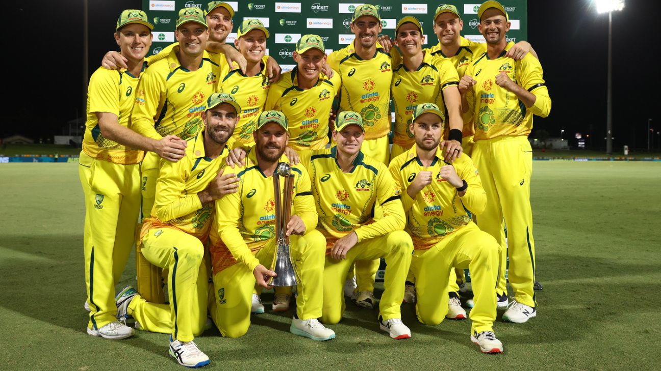
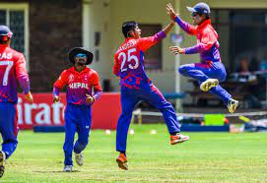
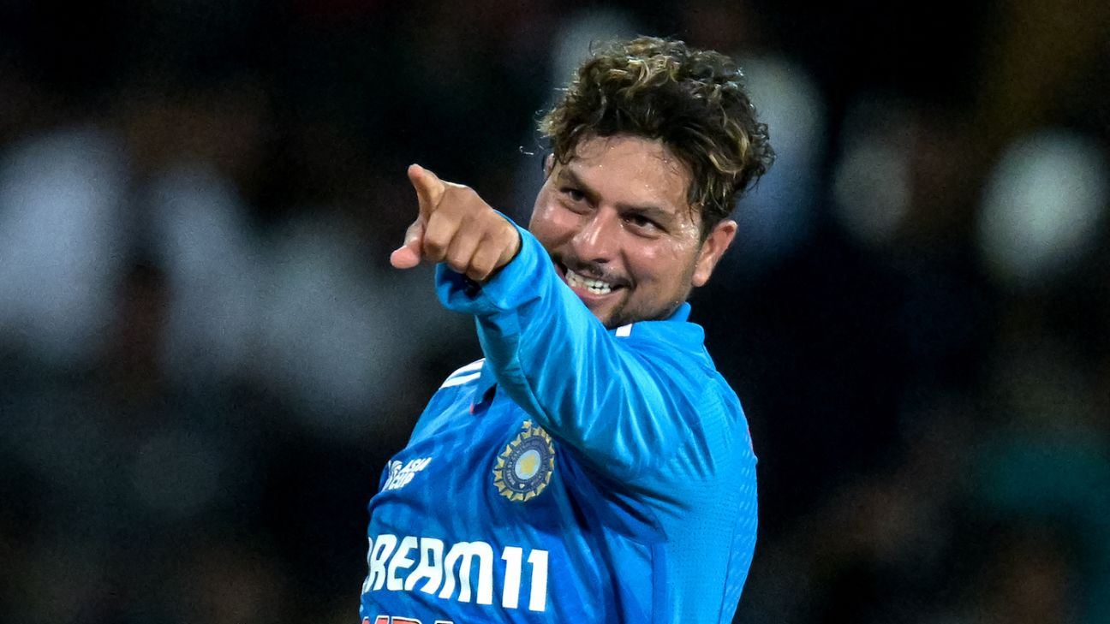
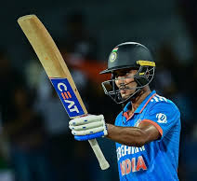
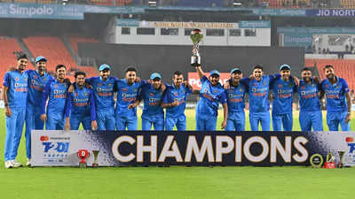
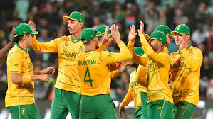



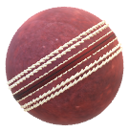
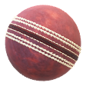

Swinging Winning Predicting
ODI Cricket Match Winners
with Machine Learning

Slide 2
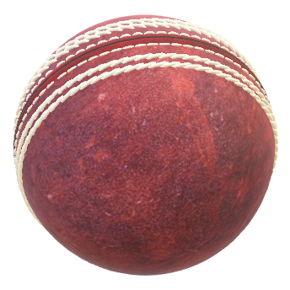
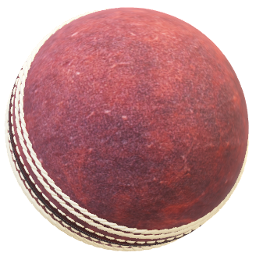
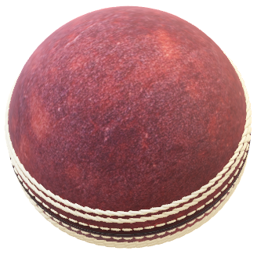
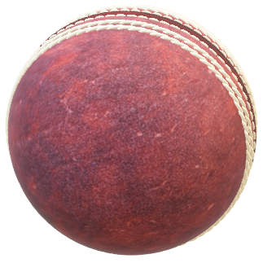
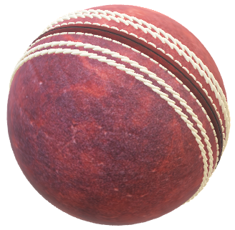
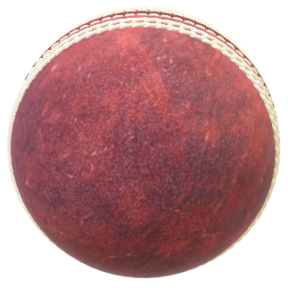
Pre-
processing
Data
Source
Data Exploration
Limitations
Methodology
Recommendations
Notes:
Introduction: This project aims to predict cricket match winners using machine learning. The motivation behind this project is to provide cricket enthusiasts, analysts, and sports enthusiasts with a tool to anticipate the outcome of one-day international (ODI) matches. By leveraging historical match data, our model seeks to address the challenges of predicting cricket match winners accurately. The final product will be a user-friendly application where users can input relevant match details, and the model will provide predictions based on historical data patterns.
Today, I'll guide you through the project's journey, culminating in a live demonstration of the application built using the machine learning model.

Slide 3
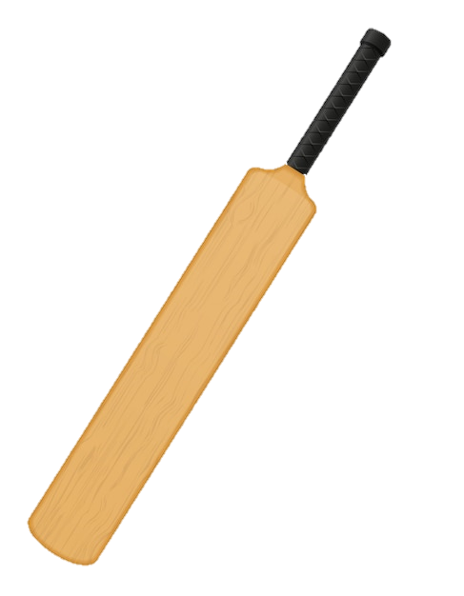




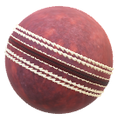
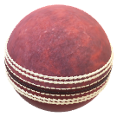
The Data
Teams, ground, winners
Scraped from www.espncricinfo.com
Missing Data, Conditions
Team Strengths
Country Performance, Venue, Recent wins
Team Names, locations... etc
Numerical Values
Notes:
Data Sources: The primary data source for this project is historical ODI match results, which include information about participating teams, the venue (ground), and various performance metrics. This data is relevant because it reflects the dynamics of cricket matches and allows the model to identify patterns influencing match outcomes. Challenges in the data may include missing values, variations in team strengths, and the impact of changing cricket conditions. Key variables influencing match outcomes include team performance, ground conditions, and recent wins.
Preprocessing and Exploratory Data Analysis: In preparing the data, we transformed categorical variables into numerical format, making it suitable for machine learning models. For example, team names were encoded, and ground locations were represented as numerical values. Exploratory data analysis revealed insights such as the impact of team performance on match outcomes and the significance of ground conditions. Simple visuals, like bar charts and scatter plots, were used to illustrate trends and patterns.

Slide 4
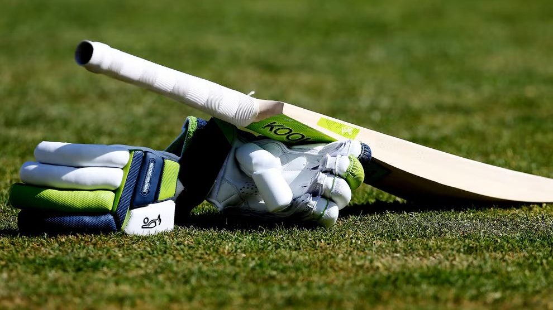
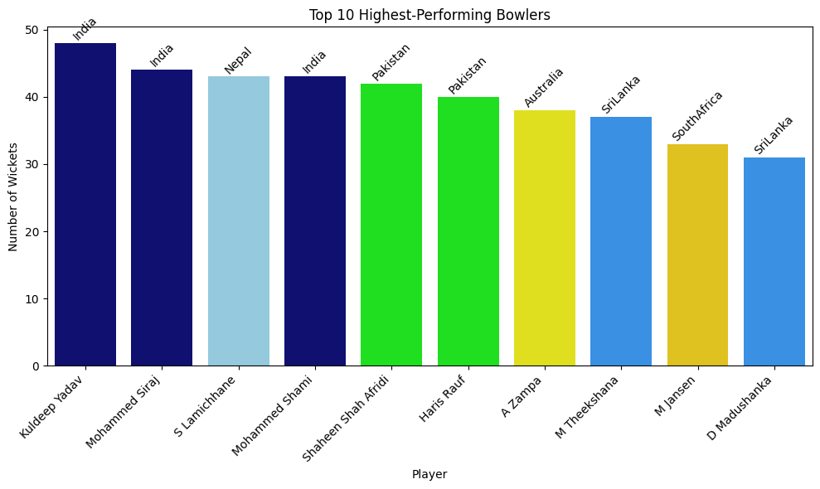
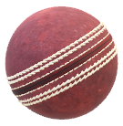

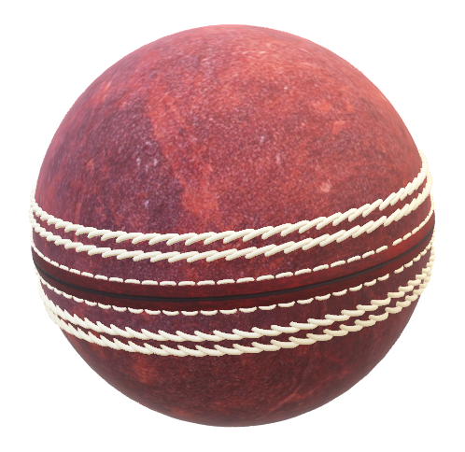
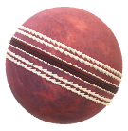
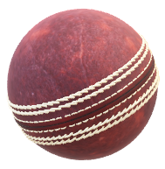
Notes:
After analyzing the data, let's delve into its insights.
The bar chart illustrates the top 10 highest-performing bowlers. It's evident that Kuldeep Yadav leads the pack, closely followed by his teammate Mohammed Siraj, both hailing from India.

Slide 5
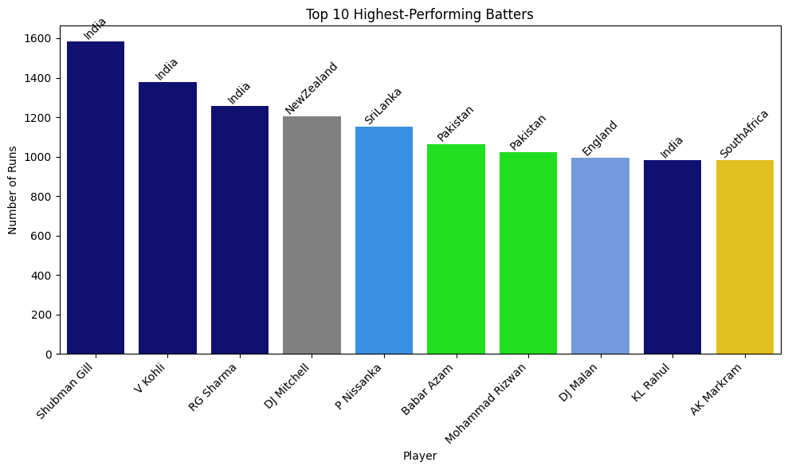
Notes:
Another bar chart reveals the highest-performing batters, showcasing India's dominance. The top three positions are secured by Indian players, with Shubman Gill at the forefront, followed by two of his teammates.

Slide 6
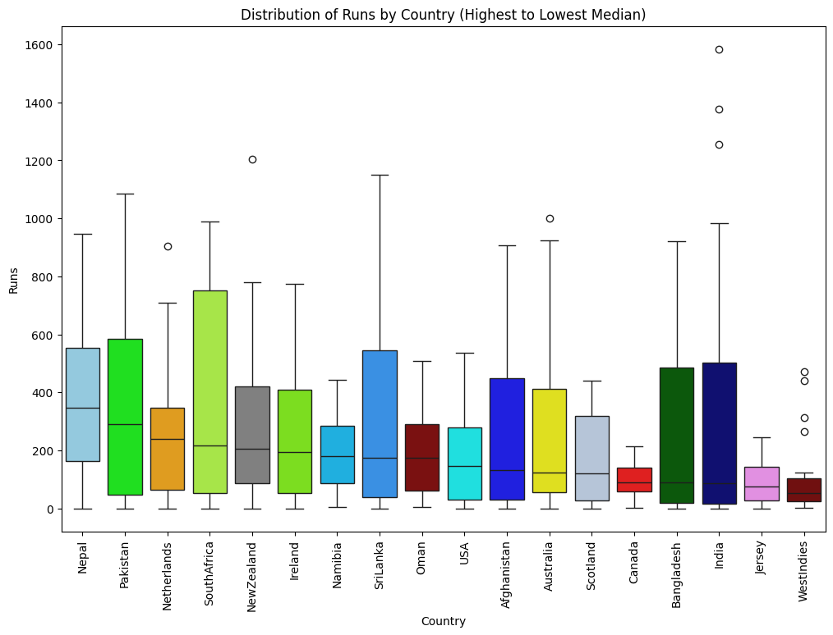
Notes:
The boxplot illustrates the distribution of runs scored by players from various countries. Here's a guide to interpreting the key elements of the boxplot:
- The line within the box signifies the median (middle value) of the data, where 50% falls below and 50% above.
- Whiskers extend from the box edges to the minimum and maximum values within a specific range, typically 1.5 times the IQR (Interquartile Range). Points beyond the whiskers are considered outliers.
- Individual data points beyond the whiskers are represented as dots, indicating potential outliers—data points significantly higher or lower than the rest.
Arranging countries based on the median runs, from highest to lowest, allows a quick assessment of which countries, on average, boast players with higher or lower runs. A higher median suggests that players from that country, on average, score more runs. This boxplot offers a visual summary of run distribution across different countries.
In this scenario, Nepal takes the lead with the highest median. However, India, while having a lower median, shows more runs overall due to outliers—indicating a few instances of high scores that significantly contributed to their total runs.

Slide 7
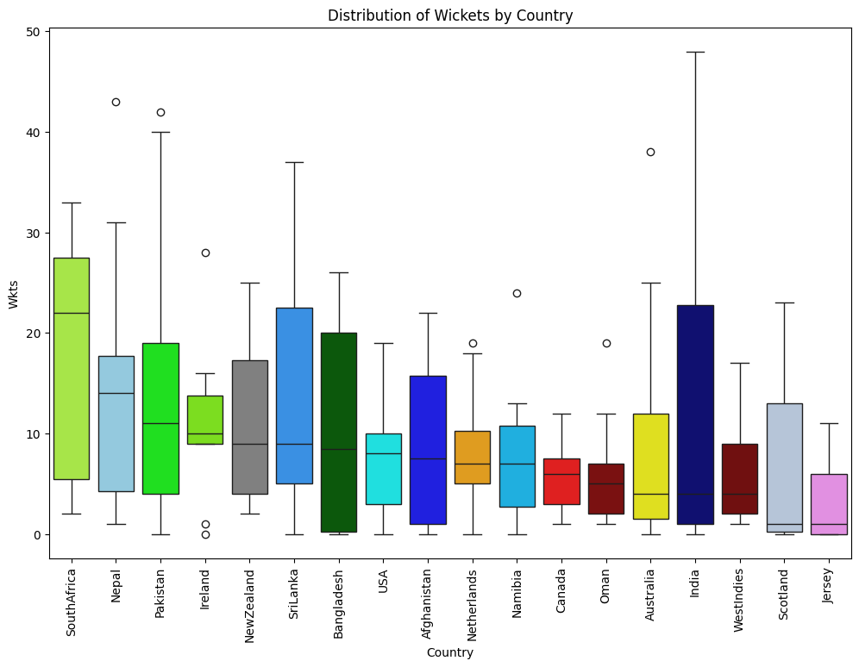
Notes:
In this box plot, it's evident that South Africa took the most wickets in the tournament. However, noteworthy is India, once again exhibiting the highest maximum value in their wicket distribution.

Slide 8
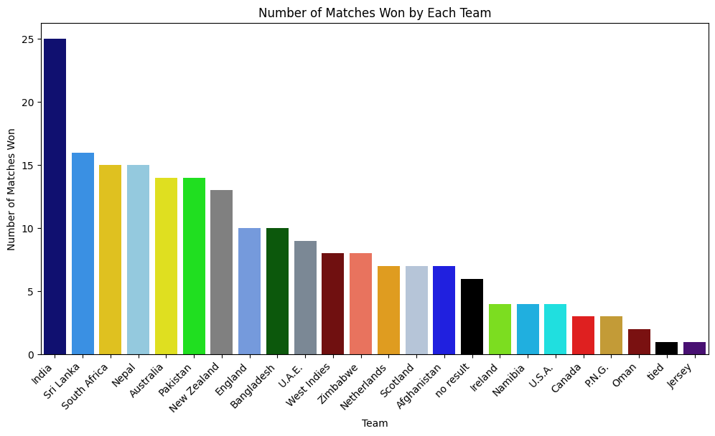
Notes:
While India secured the most victories in the tournament, the ultimate triumph in the final belonged to Australia, who defeated India by six wickets.
India earned qualification as hosts, and Afghanistan, Australia, Bangladesh, England, New Zealand, Pakistan, and South Africa qualified through the ICC Cricket World Cup Super League. The Netherlands and Sri Lanka secured the final two spots via the qualifier tournament held in Zimbabwe during June and July 2023.

Slide 9
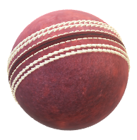
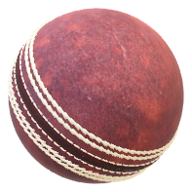
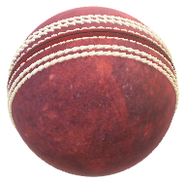
Dream Team
Batting Average (Average runs in an inning) > 35
Strike Rate (Number of runs per 100 balls) > 90
Innings Batted (Total Innings Batted) > 15
Boundry % (Percentage of runs scored as a boundary) > 40
OPENERS
Decisions and strategies
Batting Average (Average runs in an inning) > 40
Strike Rate (Number of runs per 100 balls) > 85
Innings Batted (Total Innings Batted) > 20
Av Balls faced (Average balls faced by the batter in an innings) > 25
Boundary % (Percentage of runs scored as a boundry) > 35
MIDDLE
Batting Average (Average runs in an inning) > 30
Strike Rate (Number of runs per 100 balls) > 100
Innings Batted (Total Innings Batted) > 10
Av Balls faced (Average balls faced by the batter in an innings) > 15
Innings Bowled (Total Innings bowled) > 5
LOWER
Relevant, Quality Data
Biases, Unforeseen Factors
Notes:
What other insights can we derive from the data? Focusing on One Day Internationals with a minimum score of 250, I utilized Power BI to filter the player matrix, identifying the dream team based on the specified statistics above.

Slide 10
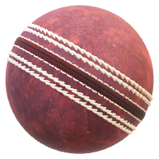
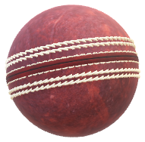
Dream Team
Batting Average (Average runs in an inning) > 25
Strike Rate (Number of runs per 100 balls) > 90
Innings Batted (Total Innings Batted) > 10
Innings Bowled (Total Innings Bowled) > 10
Bowling Economy (Average runs allowed per over) < 6.5
Bowling Strike Rate (Average number of balls required for a wicket) < 25
ALL ROUNDERS
Decisions and strategies
Innings Bowled (Total Innings Bowled) > 15
Bowling Economy (Average runs allowed per over) < 6
Bowling Strike Rate (Average number of balls required for a wicket) < 20
Bowling Style (Style of player) = '%Fast%'
Bowling Average (Number of runs per wicket) < 25
Dot Ball % (Percentage of dot balls bowled) > 1
FAST BOWLERS
Relevant, Quality Data
Biases, Unforeseen Factors
Notes:
Whats else can we do with the data? Lookin to for One Day Internationals
At least 250 score
Beast 11 Players

Slide 11

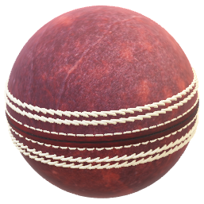

Final Over
Logistic Regression
Decisions and strategies
Relevant, Quality Data
Biases, Unforeseen Factors
Dynamic Changes, Team Performance, Player Statistics
Notes:
Methodology: Our model employs a logistic regression approach, a commonly used method for binary classification problems like match prediction (win/lose). The model's accuracy is a measure of how well it predicts match outcomes. While technical details are omitted here, the model provides a r
Recommendations: Based on the model's findings, we recommend using the predictions as an additional factor in decision-making processes related to cricket match outcomes. For example, teams, analysts, and betting enthusiasts can incorporate these predictions into their strategies for a more informed approach.eliable tool for decision-making related to match predictions.
Limitations: It's essential to recognize the limitations of our analysis. The model's accuracy depends on the quality and relevance of historical data. Potential biases or uncertainties may arise from unforeseen factors, and the model may not capture dynamic changes in team performance. Further refinements could involve incorporating more features, such as player statistics or recent team form.

Slide 12
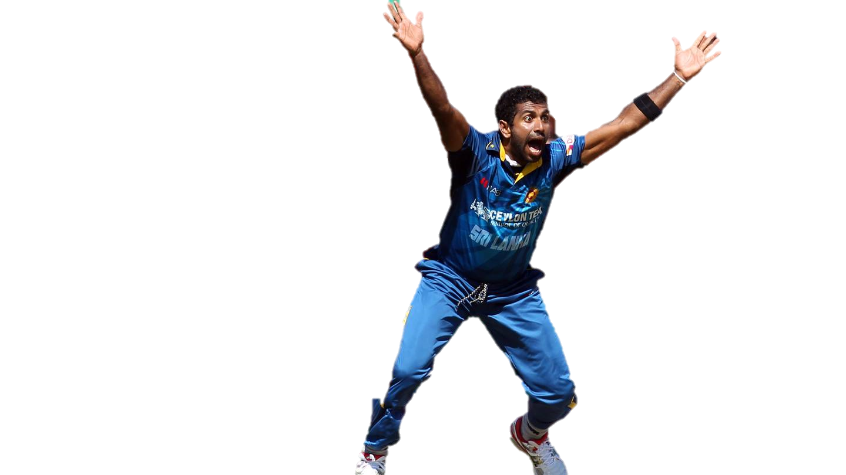

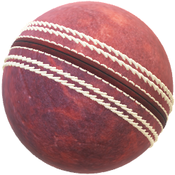
HOWZAT
Notes:
Questions and Discussion: We welcome questions and discussions about our methodology, findings, and recommendations. Engaging in a dialogue will help refine our understanding and potentially lead to enhancements in our approach or future analyses.

